Slide 1



Bus Tracking Application using Android Studio
By
180030929 K.V.V.S.N.Murthy
180030942 G.vinay perreddy
180030433 M.sandeep
Guide
B. Umamaheswara rao

Slide 2
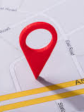
INDEX
INTRODUCTION
OVERVIEW
EXISTING SYSTEM & DISADVANTAGES
PROPOSAL & ADVANTAGES
ALGORITHM METHODS
SAMPLE APPLICATION PICTURES
CONCLUSION
Reference

Slide 3
Introduction
Generally Bus tracking is done with a special device installed in every bus.
But now a days every one uses a smartphone .This application gives the location of bus by using the location of driver’s mobile or conductor’s mobile

Slide 4
Overview of Android Studio
Android Studio is the official IDE for Android application development.
On top of the capabilities you expect from Android Studio , it offers:
1.) Flexible Gradle-based build system
2.) Build variants and multiple apk file generation
3.) Code templates to help you build common app features

Slide 5
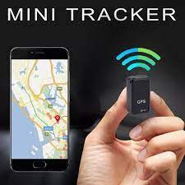
EXISTING SYSTEM & DISADVANTAGES
As of now there is no proper application for tracking bus
There are some online bus tracking sites but they doesn’t work properly
they doesn’t show the exact location of bus they will just show the name of the area

Slide 6
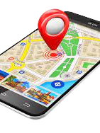
Proposal & Advantages
Now, we are developing the application using android studio
It is one of the good studio to develop mobile application
Android Studio provides the fastest possible turnaround on coding and running workflow
It uses google gps services to track the bus

Slide 7
ALgorithms
V-CLIQUE algorithm
- Predicting Bus Arrival Time on the Basis of Global Positioning System Data.
The Advanced Traveler Information Systems (ATIS)
- which provide real-time information about public transit to the commuters

Slide 8
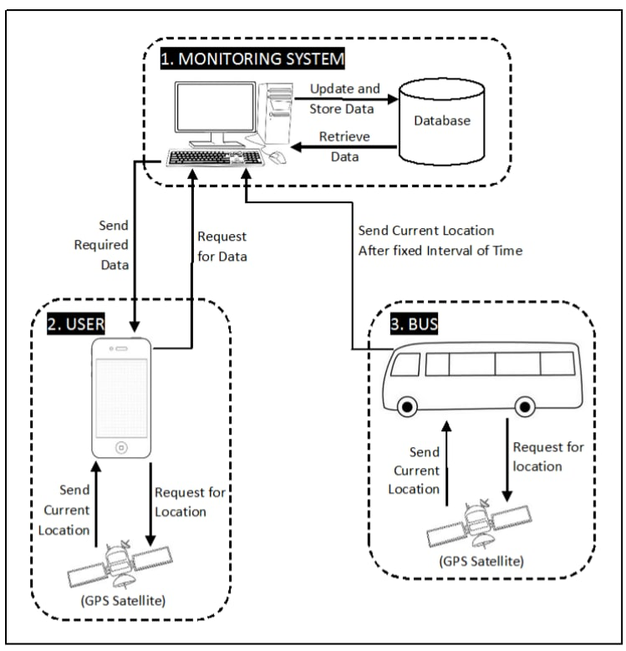

Slide 9
Literature Survey
Singla, Leeza & Bhatia, Parteek. (2015).
GPS based bus tracking system. In this fast life, everyone is in hurry to reach their destinations.
In this case waiting for the buses is not reliable.
People who rely on the public transport their major concern is to know the real time location
of the bus for which they are waiting for and the time it will take to reach their bus stop.
This information helps people in making better travelling decisions.

Slide 10

Conclusion
With this application we can track the bus location in google maps which is familiar to the android users which uses mobile gps services in android devices.

Slide 11
Reference
http://www.apsrtclivetrack.com/#/
Singla, Leeza & Bhatia, Parteek.:https://mobilenumbertracker.com/
https://support.google.com/accounts/answer/3118687?hl=en
https://developer.android.com/training/location

Slide 12


